Slide 1
Managing Allegations Against Adults Briefings
Katherine Appleton – Local Authority Designated Officer

Slide 2
Aims of the session
To understand what constitutes an Allegation
To understand the LADO process
To develop a safe environment for children

Slide 3
How do we keep children safe
Can you give me examples of how organisations keep children safe.
Notes:
DBS – only as good as the day it was written unless it is a portable DBS
Lots of roles are now exempt from DBS checks these roles are those that are not employed to work with children- community centre volunteers in a café shop can not be checked so how do we know they are safe? Supervision, clear guidance to parents on organizational and staff rules. Codes of conduct for staff – you are not permitted to make contact with children outside of this setting, you must declare developing freindships with service users?
Just because they want to support their local faith group does not mean they are safe or unsafe.

Slide 4
How are we here today
Court Lees
Marie Coldwell
Cleveland enquiry
Melanie Klien house
Staffordshire Pindown
Notes:
Number of high profile inquiries changes in legislation there are too many to go into but I want to remind you of the ones that we have potentially forgot. I would encourage you all after today to go back to the office and get staff members to all read different inquiries and serious case reviews and come together to discuss them in order to think about how individually you make sure that they can not happen again.
Court Lees – exsessive use of physical punishment leaving children with injuries up to 6 weeks after the event, children were heard screaming – a pathologist remarked that the canings were not that bad no worse that you used to get in school
Melanie Klien House – sexual and physical abuse of girls with staff who had no experience or training
Staffordshire pindown enquiry – children were placed in rooms for weeks and months one instance up to 84 days – little furniture no conversations

Slide 5
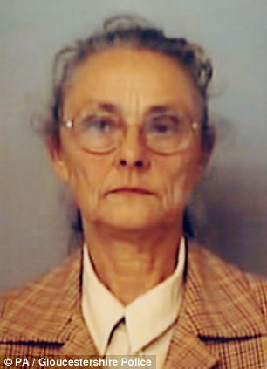
Eunice Spry
Notes:
Privately fostered 4 out of the 5 children she fostered by arrangement with their birth parents
1 of the 5 children was placed by CSC
3 of the children who were siblings were given residence orders to Mrs Spry
By 1994 – all 5 children were removed from school
12 separate allegations were made
Social workers described her as eccentric –
At one point three of the children were medicated with ritilin as she complained about behavioural problems
In 2000 a serious car accident killed Ms Sprys oldest daughter and one of the privately fostered children. one of the children used a wheelchair until she left her care at 18 and was then able to walk.
In dec 2004 the 18 yr old made allegations of physical and emotional abuse the two younger boys who still lived with her were spoken to and collaborated the allegations with one later disclosing sexual abuse
The adoption of the two girls was delayed by three years as professionals had concerns but eventually the adoption was approved due to the view that the children needed stability
In 1991 a team manager advised she would not support the adoption due to concerns raised by school about her treatment of the two girls the manager commenced an assessment which was not completed as Ms Spry would not engage. The court granted the asoption anyway and without concluding the concerns. Ms Spry then removed the children from school
FII was considered due to Ms Spy inclination to seek out a private dr to perscribe ritilin this was given for many years without the children being seen.
The professionals views of her differed CSC and education raised concerns health also raised concerns but health visitors police and playschool advised she had good parenting skills. CSC had intermitant concerns
Children alleged horric abuse from being forced to eat their own vomit to being starved and beaten forced to eat rat excrement, beaten on the soles of their feet, confined to a wheelchair, medicated, rub the childrens faces in dog feaces
One of the children attended church with a sign around her neck saying this child is evil do not speak to her this was not challenged by any one in the congregation..
The children were never allowed to be seen without her
All children had development delay around communication and were seen as different
Mrs Spry managed to convince many professionals of her competence and caring nature
Lack of communication
Lack of challenge
Lack of coordinated investigation

Slide 6
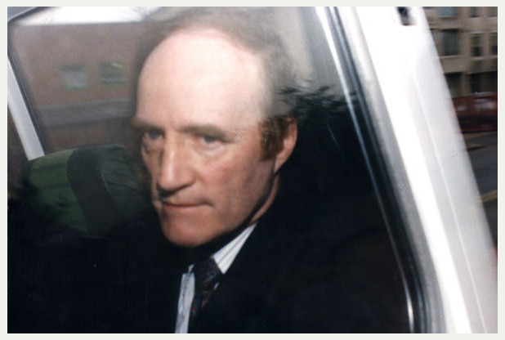
Frank Beck
Notes:
Frank beck had previous allegations made against him but was recruited anyway.
Most of the employers he had were referred for the job by him and had no qualifications
He developed regression therapy which he used to openly abuse the children and which was hailed by some professionals in the authority as good practice and disseminated to other homes. REGGRESSION THERAPY WOULD SEE HIM DRESS THE CHILDREN IN NAPPIES CUT UP THE FOOD FOR THEM ENCOURAGE HIS STAFF T CUDDLE AND HOLD THE CHILD AND BATH THEM.
He openly logged incidents of physical punishment which were not challenged by social workers
He ignored instructions not to use regression therapy on some children but faced no consequences
There were multiple complaints against him
He was approved as a foster carer whilst awaiting trial
After two complaints were made against Beck by two staff members beck submitted his resignation after being told he would be suspended. He received a reference from the director of CSC who did not mention that personel department had suspended him and he had subsequently resigned.
Previous concerns and allegations were ignored by senior managers and some social workers for the children also dismissed the allegations.
Frank Beck used the excuse that he through the first punch in self defence to prevent himself from being assualted

Slide 7
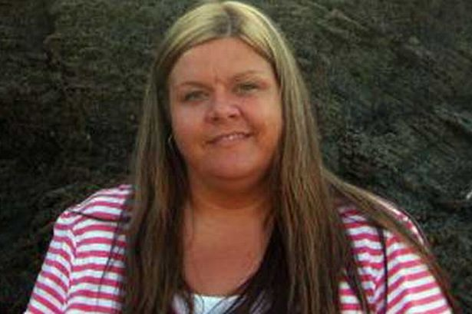
Venessa George
Notes:
Convicted of abusing , making and distributing indecent images of children.
Using her mobile phone to abuse the children whilst changing them
Whilst nursery staff advised they had become concerned about the language that she used and her conversations regarding adult sexual contact it had not been challenged.
Just a few months prior to the abuse OFSTED judged the setting as Good and it provided a safe and protective enviornment for children.
This case shocked the country again

Slide 8
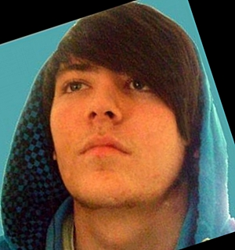
Paul Wilson
Notes:
Just 3 years after venessa George there was Paul wilson
20 year old paul wilson was investigated by the police on suspicions that he was grooming a teenager
Upon searching his home and examining computer equipment and other media it was identified that he had also abused a child within the nursery setting.
He was described as a lovely young man polite
He was convicted of 47 counts of sexual abuse

Slide 9
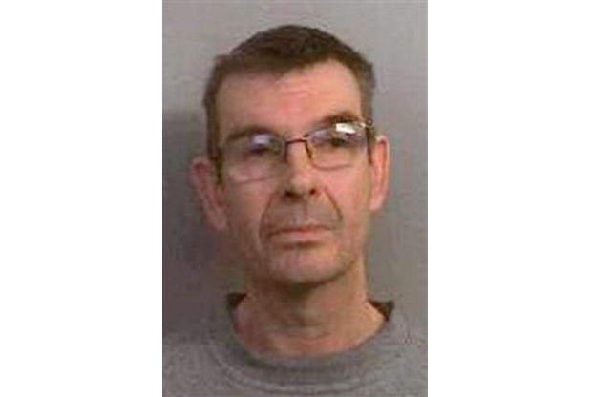
Nigel Leat
Notes:
The school heard of at least 30 incidents were his behaviour was considered inappropriate or unproffessional
Only 11 of those incidents were reported formally to the school
In December 2010 a child disclosed to her mother that she had been sexually abused by him nearly every day for two months.
Upon his arrest he was found to have 30,500 indecent images on his computer.
OFSTED judged the school as outstanding during inspections
The SCR determined failings of the school to address the concerns raised or follow procedures.
The LADO was never contacted.
It was reported that his behaviour of selecting Star pupils was so well known and made teachers uncomfortable enough to try and prevent pupils likely to be targeted by Leat being put in his classes.
Teachers saw him protjecting an indecent image of an adult on the class wall another pupil complained that he had kissed her making her physically sick whilst another parent complained he had been taking photos of her daughter.
He admitted 36 sexual offences and was given an indeterminate sentence.

Slide 10
Gut feelings
In all the cases mentioned professionals talked about gut feelings
Some discussed knowing there was something not quite right
He gave me the creeps
She’s eccentric
He was lovely so polite
Notes:
When jimmy saville was accused of sexual abuse how many of you thought yep that makes sense?
How many could not believe he could do this?
Max Clifford
How many thought no not max clifford?
How many thought yes that makes sense
Fred the weather man
How many thought yes I was waiting for his name?
That is so wrong?
Ken Barlow
Who thought yes deffinately new all along?
Who was shocked that ken could be accused of such a thing?
Ralph harris
Dear old Ralph who thought yes deffinately?
Who thought it was all a lie?

Slide 11
GUT FEELING
Humans were born with certain responses
Fight or flight
Gut feelings
Notes:
We are taught to ignore these go with the facts were is the evidence ………..
I say listen to them feelings if you as an adult thinks I am uncomfortable in this persons presence we decide to leave
If as a professional you are uncomfortable with how a colleague behaves log it speak to a manager about it, you consider what it is that makes your gut believe that there is something not right and this allows us to be open minded. It allows us to question and not ignore.
Just as we are open to this we also have to accept we could be wrong that’s why evidence is crucial to formally respond

Slide 12
Commonalities with the offenders
Recent loss of relationships/ emotional closeness
• Emerging sexual orientation
• History of self harm/suicidal thoughts
Rule breaking
• Some offenders showed patterns of rule breaking
Notes:
Think about Frank beck rule breaking- he was right he did what he wanted and refuted and refused to go with instructions

Slide 13
commonalities
Own experience of abuse
Work related stressors
• Lack of support; working many hours
Some showed generally they were rule breaker
Notes:
Rule breakers think of Beck
Work related stress school teacher

Slide 14
BICHARD
For those agencies whose job it is
to protect children and vulnerable
people, the harsh reality is that if a
sufficiently devious person is
determined to seek out
opportunities to work their evil, no
one can guarantee that they will be
stopped. Our task is to make it as
difficult as possible for them to
succeed…”
Notes:
Jessica chapman and holly wells
DBS checks are out of date the moment they are done.
Ian huntly was not employed to work with children
Changes in vetting leaves setting very vulnerable – the importance of creating a culture were staff know that the managers are interested in the children listen to the children etc is even more important.

Slide 15
Mary Faithful foundation
Reduce the risks
Increase the difficulty for the offence to occur
Think about transparency
Develop a culture of challenge
Develop a setting that implements its standards visually
Notes:
If you travel on the london underground now you will notice that all the carrages are no longer separate you can see from one end to the other if it is straight – this was a purpusful design to reduce the opportunity for crimial behaviour
Safer recruitment practises

Slide 16
How to create a positive environment
Residential Homes
Foster placements
Schools
Nurserys
Child minders
Community groups
Notes:
I want us to think about how we create safer working environments?
Nigel leat – classrooms with unabsructive glass windows
Demonstrating as practitioners we listen, we are interested, we will not ignore
Reinforcing regularily to staff their responsibilities to report concerns
Unannounced visits where we do not take no for an answer
Not allowing the use of media
Acknowledging it could be anyone
Challenge
If I were to say that a person had downloaded child pornography how many of you would challenge me?
If some puts hand up ask them why?
To those who do not ask them what would stop them?

Slide 17
What is an Allegation?
When a person who works with children has:
behaved in a way that has harmed, or may have harmed, a child;
possibly committed a criminal offence against or related to a child; or
behaved towards a child or children in a way that indicates they may pose a risk of harm to children
Notes:
So this is now the criteria for LADO referrals

Slide 18
LADO is not responsible for…
Issues of suitability
Where an employee is being investigated for an offence against an adult, or their behaviour in their personal lives brings into question their suitability to work with children, it is the responsibility of the employer to determine issues of suitability and take appropriate action
Undertaking investigations
It is the role of the employer (or the Police) to conduct investigations into allegations
Determining the use of suspension
It is the role of the employer to determine whether the suspension of the employee is required
Notes:
Working Together 2013 amended the role of LADO and issues of suitability were removed from the LADO’s remit.
Who’s responsibility is it to decide to suspend?
What action should be taken prior to this decision?
What must you do if you decide not to suspend?

Slide 19

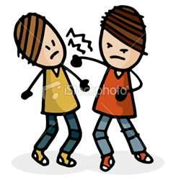
Types of Harm
SEXUAL
Includes…
Sexual relationship with a child
Sexual contact with a child
Inappropriate touching
Sexual innuendoes
Telling of dirty jokes
Use of pornographic material
The taking of indecent images of children
Accessing indecent images of children
PHYSICAL
Includes…
Pre-meditated physical assault
Use of physical chastisement
Injury caused by Intervention
Inappropriate use of Intervention
Any injury or mark caused by staff member
Aggressive physical assault
Rough handling
Notes:
Sexual – if you become aware of sexual harm indecent images etc you must contact the police. Feel free to ring LADO first but you must not delay this type of situation. Think nursery working taking photos think teacher running off with a pupil. If you notify the professional in these situations you are likely to scupper police investigations. Incorrect management of these has significant consequences.
Physical Chasisment in a work setting is assault only parents have the right to physically chastise their own child.
Intervention that has resulted in harm physical bruising – teachers are able to restrain but if you restrain it must comply with the restraint used by the school.

Slide 20

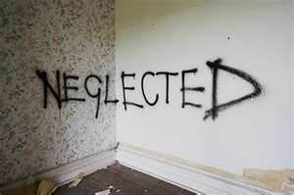
Types of Harm
EMOTIONAL
Includes…
Bullying
Degrading behaviour or remarks
Persistent hostility
Persistent intimidation
Persistent humiliation
Verbal abuse
Threatening but not physical behaviour
Harassment
Racism
NEGLECT
Includes…
Placing children at risk
Failure to follow procedures and policies
Failure to meet the care needs of children
Failure to address the needs of ‘children in need’ and other vulnerable groups
Notes:
Neglect
For example failing to adequately follow procedures resulting in a child being harmed needs to be considered on an individual basis. For example an employer fails to act on a disclosure made by a child to them this is an issue of professional misconduct and will also include issues around suitability to practice in the event that the failure relates to a belief held by them about the nature of the abuse. This is no longer for the LADO but is for the employer to address. However the LADO would want to be made aware of a professional who employs a person who they know to have been convicted of an offense against a child but employ them anyway as their personal veiw is that they do not pose a risk. LADO wants to be aware of these concerns due to the criminal nature of employing a person who poses a risk to children and has responsibility to ensure that the LSCB considers the overall organisations capacity to safeguard a child.

Slide 21
What is LADO?
Local Authority Designated Officer (LADO)
0151 511 7229
Responsible for…
Monitoring and tracking of individual cases
Providing consultations with Senior Managers
Liaising with Senior Managers, Police, CPS, Ofsted and DBS
Chairing AAA Strategy Meetings
Liaising with and reporting to the LSCB
In Halton the named LADO is Katherine Appleton. There is a duty system in place which uses the Independent Reviewing Managers for consultations and chairing of Strategy Meetings
Notes:
Local authorities are required to ensure that they have designate officers (the Local Authority Designated Officer, or LADO) to be involved in the management and oversight of individual cases – providing advice and guidance to employers and voluntary organisations, liaising with the police and other agencies and monitoring the progress of cases to ensure that they are dealt with as quickly as possible consistent with a thorough and fair process.
Halton figures 2012-13
Total number of allegations – 39
Referrals by agency:
Social Care – 5
Education - 20
Childcare – 6
Faith Group – 1
Voluntary Youth Group – 1
Other – 6
Category of allegation:
Emotional – 5
Neglect – 0
Professional Misconduct – 7 (Professional misconduct referrers to a professional’s inappropriate response to young people and can involve behaviour in either their professional or personal lives)
Physical – 21
Sexual – 6

Slide 22
What to do when you receive an allegation
Inform your safeguarding lead or designated person He/she should then;
Gather initial information
Was the staff member in work that day?
Was there opportunity for them to be with the child?
Complete the consultation form
Do not leave message for Me ask for the duty LADO
Notes:
In order to ensure appropriate record keeping and understanding of advice given we expect that agencies complete the consultation form even if they are not making a referral but just want advice.
This means both parties have a record that it the same and con not be misinterpred

Slide 23
Organisation Roles
All Organisations should identify a lead person (Senior Manager) within their organisation that will deal with allegations against a professional.
The Senior Manager is…
Identified within employers’ procedures
The person to whom allegations are reported
The person to liaise with LADO
Examples:
For schools this will be the Head Teacher
For pre-schools, nurseries & link clubs this will be the Manager
For voluntary groups it will be the manager or chair of the committee
For Churches it is the safeguarding leads
Notes:
Named Senior Officers take on a strategic role within their organisations. Their responsibilities include making sure that:
their own agency procedure complies with the LSCB’s procedures for managing allegations;
the workforce is aware of and implements the procedures;
there are systems in place for reviewing cases, learning lessons and improving procedures and practice;
that there are effective recording and reporting arrangements in place.
THIS WOULD USUALLY BE THE CHAIR OF GOVERNORS WITHIN A SCHOOL SETTING
Named Senior Managers take on the more operational role within the allegations process and would be the person to whom allegations are reported. They would then take on the responsibility of liaising with the LADO and undertaking any subsequent investigations.
THIS WOULD USUALLY BE THE HEAD TEACHER / PRINCIPAL WITHIN A SCHOOL SETTING
LADOs’ responsibilities include:
providing advice, information and guidance to senior managers and liasing with others involved e.g. Police, CPS etc;
ensuring a consistent and thorough process is followed for all adults against whom an allegation has been made;
overseeing and monitoring cases to ensure they are dealt with in accordance with procedures and recommended timescales;
maintaining an allegations database and reporting to the LSCB and Dfe as required;
contributing to training and raising awareness about allegations management procedures.

Slide 24


Dealing with allegations of abuse
Quick resolution of the allegation must be a priority
Do not investigate
Do identify whether the alleged incident could have taken place i.e. was the staff member in work at the time of the allegation, etc.
Swiftly rather than slowly…
Organised
Sloppy

Slide 25

The Strategy Meeting
If the LADO is in agreement that the threshold is met, a strategy meeting will take place. It must be convened within 5 days of receiving the initial referral and attendees will include:
LADO
Police
Employer
Human Resources
Ofsted / other regulatory bodies (where appropriate)
Notes:
The meeting will consider the course of investigation along with any lessons to be learnt, timescales and who is responsible for what. The LADO will also oversee that the agreed actions are undertaken.
Do not say to me I don’t believe it!
Do not say yes well there no angel!

Slide 26
Information required at the Strategy Meeting
Regarding the Employee:
DOB / Address / Family details (where known)
Date of recruitment
Last DBS check
References sought and followed up
Any previous complaints / allegations
Any registration with professional bodies
Any known personal issues
Confirmation of advice regarding Unions
Is the Employee still in the place of work / suspended?
Details of identified school contact
Notes:
It is important to recognise that the professional that the allegations are against is likely to be distressed and therefore it is important to ensure that support is offered. The named contact person in the organisation should understand and be familiar with were additional support can be accessed. They should be aware of their trade unions.

Slide 27
Information required at the Strategy Meeting
Regarding the Allegation:
Witness details
Details of any immediate safeguarding action taken
Regarding the Child:
DOB / Address / Parents notified
Initial disclosures and to whom
Decision to involve the Police by the family
Identified disability / SEN
Any behaviour plans / difficulties
Any known personal issues
Previous allegations / complaints
Notes:
Parents need to be notified when their child is identified in an allegation however this should be done in conjunction with the discussion with the LADO this is to clarify the amount of information to be shared. Parents should also be spoken to about the possible implications on discussing the allegations with others this may include prosecution as teachers anonymity is protected until a judge declares otherwise or they wave their right to anonymity by going public themselves it may also impact on the investigation process.
Knowing about any specific behaviour plans and learning needs is an important and relevant piece of information, for example is the child able to understand time and if they are challenging how do the school and parents agree that the behaviour is managed.

Slide 28
Strategy Meeting Agenda
The Strategy Meeting will follow a set agenda and will consider the following:
Any other children that the professional has contact with and action to keep them safe
Any information in respect of the person making the allegation that would impact on the validity of the allegation
Any information in respect of the professional including previous allegations, complaints, conduct and relationship between the professional and the family of the child
Support for the child and other children who may have witnessed the incident or reported the incident
Support required for the professional
Whether the recruitment process for the professional was robust and followed Safer Recruitment guidelines
Potential media interest in the case
Timescales for review
Any points of learning
Notes:
The agreed plan will be distributed to group members within 24 hours.
The notes produced from the strategy meeting will be completed and distributed to all members of the group within 15 working days.

Slide 29
Investigation
There are usually to outcomes to the first strategy meeting
Police investigation
Or
Agency investigation
The strategy meeting will agree the terms of any investigation
Notes:
The investigation will look at the allegation, speak with the professional, speak with any witnesses and will include referring to schools policies and procedures. Whilst you are able to agree the investigating officer prior to the strategy meeting they will make no attempt to investigate until confirmation is sought from the family that they are not intending to notify the police. On occasions it will not be possible for the senior manager to investigate or where the nature of the allegations are complicated, it maybe that an independent person investigates. This will need to be arranged by the organisation.
When the organisation has investigated the allegations the completed report will be shared with the strategy group. This will allow for any further questions or clarification to be sought about the information gathered. The investigation should conclude with an outcome (substantiated, unsubstantiated, false or malicious) and should have some recommendations, which may include training or updating procedures. This is an important part of the process as it allows for the strategy group to discuss any additional recommendations.

Slide 30
SUPPORT
You must support your staff member
You must support the alleged victim
You must support witnesses

Slide 31
Conclusions
At the conclusion of the investigation, the allegation will be found to be:
Substantiated - there is evidence to support the incident happened
Unsubstantiated - the allegation cannot be proven or disproven
unfounded - there is evidence to confirm that the incident did not happen
Malicious - there is evidence that the incident did not happen and that the allegations are motivated by the intention to have a professional dismissed (where allegations are deemed to be malicious and this constitutes a criminal offense further consideration must be given to referring the matter to the Police)
Notes:
Unfounded is coming back for all agencies except schools

Slide 32
Informing relevant bodies
In cases where the employer decides that they can no longer employ the professional/voluntary worker, a referral should be made by the employer to the Disclosure and Barring Service (DBS)
Notification should be sent of the decision to dismiss to any other registered body
This information should also be shared with LADO
Notes:
Referrals are made to the DBS when an employer or an organisation, for example, a regulatory body, has concerns that a person has caused harm or poses a future risk of harm to vulnerable groups including children. In these circumstances the employer or regulatory body must make a referral to the DBS.
You have a legal responsibility to refer.
In the event that you do not the LADO will refer and will notify the DBS that you have refused or failed to do it in a timely manner.
You can refer for other issues and these can be found on the DBS website but for example – a proffessional who uses extreme pornography, Domestic Abuse, sexual arousal over things that indicate they may be unsutable to work with children for example foot fetish

Slide 33
Do not…
Conduct an internal investigation without first consulting with the LADO
Advise the employee of the details or nature of the allegation (this may potentially impede a Police investigation)
Use compromise agreements
Notes:
Failure to notify the LADO of allegations and investigating allegations that meet the LADO threshold without agreement is a failure of the organisation to follow statutory guidance.
Compromise agreements should not be used in cases were the threshold is met. You have a statutory duty to refer to the DBS and other governing bodies when the threshold is met and concerns are substantiated and dismissal is used.

Slide 34
Record Keeping
False and malicious allegations must be removed from the personal record
For all other allegations a summary should be written and a copy provided to the person
Retention of records is until the employee has reached the age of retirement or 10 years after the allegation if this is longer.

Slide 35
DBS
Referrals to the DBS are your responsibility.
OFSTED
Identified LADO as a strength
Notes:
Ofsted identified LADO as a strength here this means that we all do a good job.

Slide 36
Any questions?

Slide 37
Important contacts
LADO - 0151 511 7229
i-CART team - 0151 907 8305
DBS

